Slide 1
Conservation Status of Species
Research for the National Park Service

Slide 2
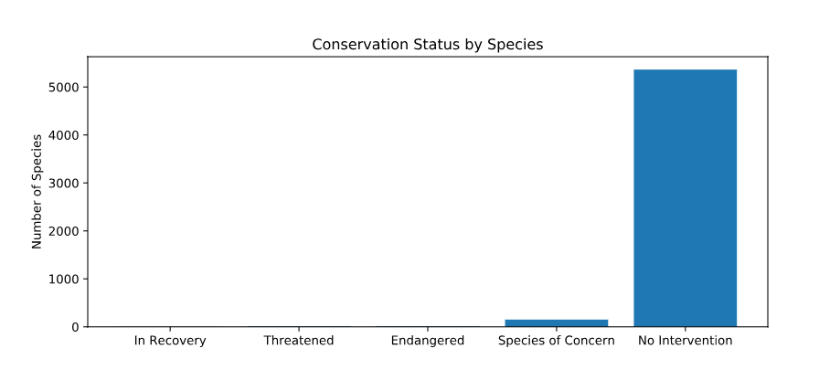
Conservation Numbers : Overview
conservation_status scientific_name 0 Endangered 15 1 In Recovery 4 2 No Intervention 5363 3 Species of Concern 151 4 Threatened 10
Conservation Status | Number of Species
Endangered | 15
In Recovery | 4
No Intervention | 5363
Species of Concern | 151
Threatened | 10

Slide 3
Likelihood of types of Species Being Endangered
Initial Observations:
Mammals have a higher chance of being endangered compared to other species
Plants have lowest percentage of being endangered
 | Not Protected | Protected | Percent Protected
Amphibian | 72 | 7 | 8.86
Bird | 413 | 75 | 15.37
Fish | 115 | 11 | 8.73
Mammal | 146 | 30 | 17.05
Nonvascular Plant | 328 | 5 | 1.50
Reptile | 73 | 5 | 6.41
Vascular Plant | 4216 | 46 | 1.08

Slide 4
Chi Square Test Applied
Chi Square performed to answer the question if certain types of species are more likely to be endangered
Results significant if p value < 0.05 (reject null hypothesis)
Results:
Percentage of protected mammals vs birds : p-value = 0.688
Percentage of protected mammals vs reptiles : p-value = 0.038
Conclusion: Mammals are more likely to be endangered compared to reptiles, but not to birds.

Slide 5
Foot and Mouth Disease Reduction in Sheep
Purpose: To use Sample Size calculator to determine the number of sheep to observe to detect significant change

Slide 6
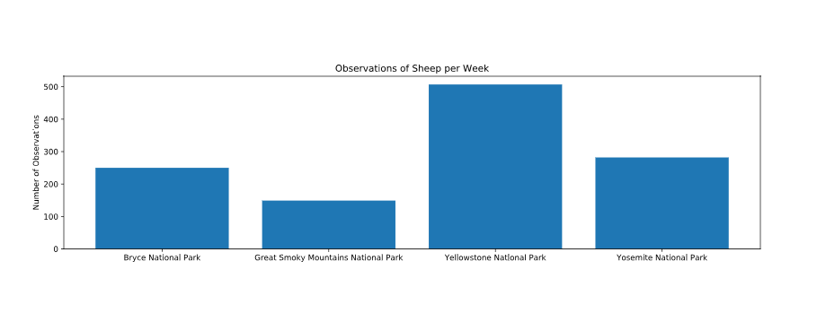
Sheep Sightings

Slide 7
Foot and Mouth Disease Reduction Conditions
Baseline percentage is the number of sheep affected last year = 15%
Minimum detectable effect is the percentage of baseline for observed change= 33%
Statistical significance of 90%
Need a sample size of 510

Slide 8
Recommendations
In order to determine statistical significance of a 5% drop in foot and mouth disease, you need to observe 510 sheep
To collect the data, observe sheep for 1 week in Yellowstone National Park or 2 weeks in Bryce National Park

